Slide 1
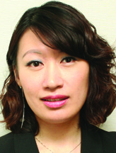
DNA奇妙系列與PetHealth系列分享
DNA Miracles and PetHealth
Emmy Yeung
產品拓展經理
Product Manager
本簡報中提到的收入等級純屬舉例說明，無意代表美安香港超連鎖™店主的一般收入，也無意表示任何超連鎖™店主皆可賺取同等收入。美安香港超連鎖™店主的成功與否，取決於其在發展事業時的努力、才能與投入程度。
The income levels mentioned in the following presentation are for illustration purposes only. They are not intended to represent the income of a typical Market Hong Kong UnFranchise ™Owner, nor are they intended to represent that any given Independent UnFranchise ™ Owner will earn income in that amount. The success of any Market Hong Kong Independent UnFranchise ™ Owner will depend upon the amount of hard work, talent, and dedication which he or she devotes to building his or her Market Hong Kong Business.

Slide 4
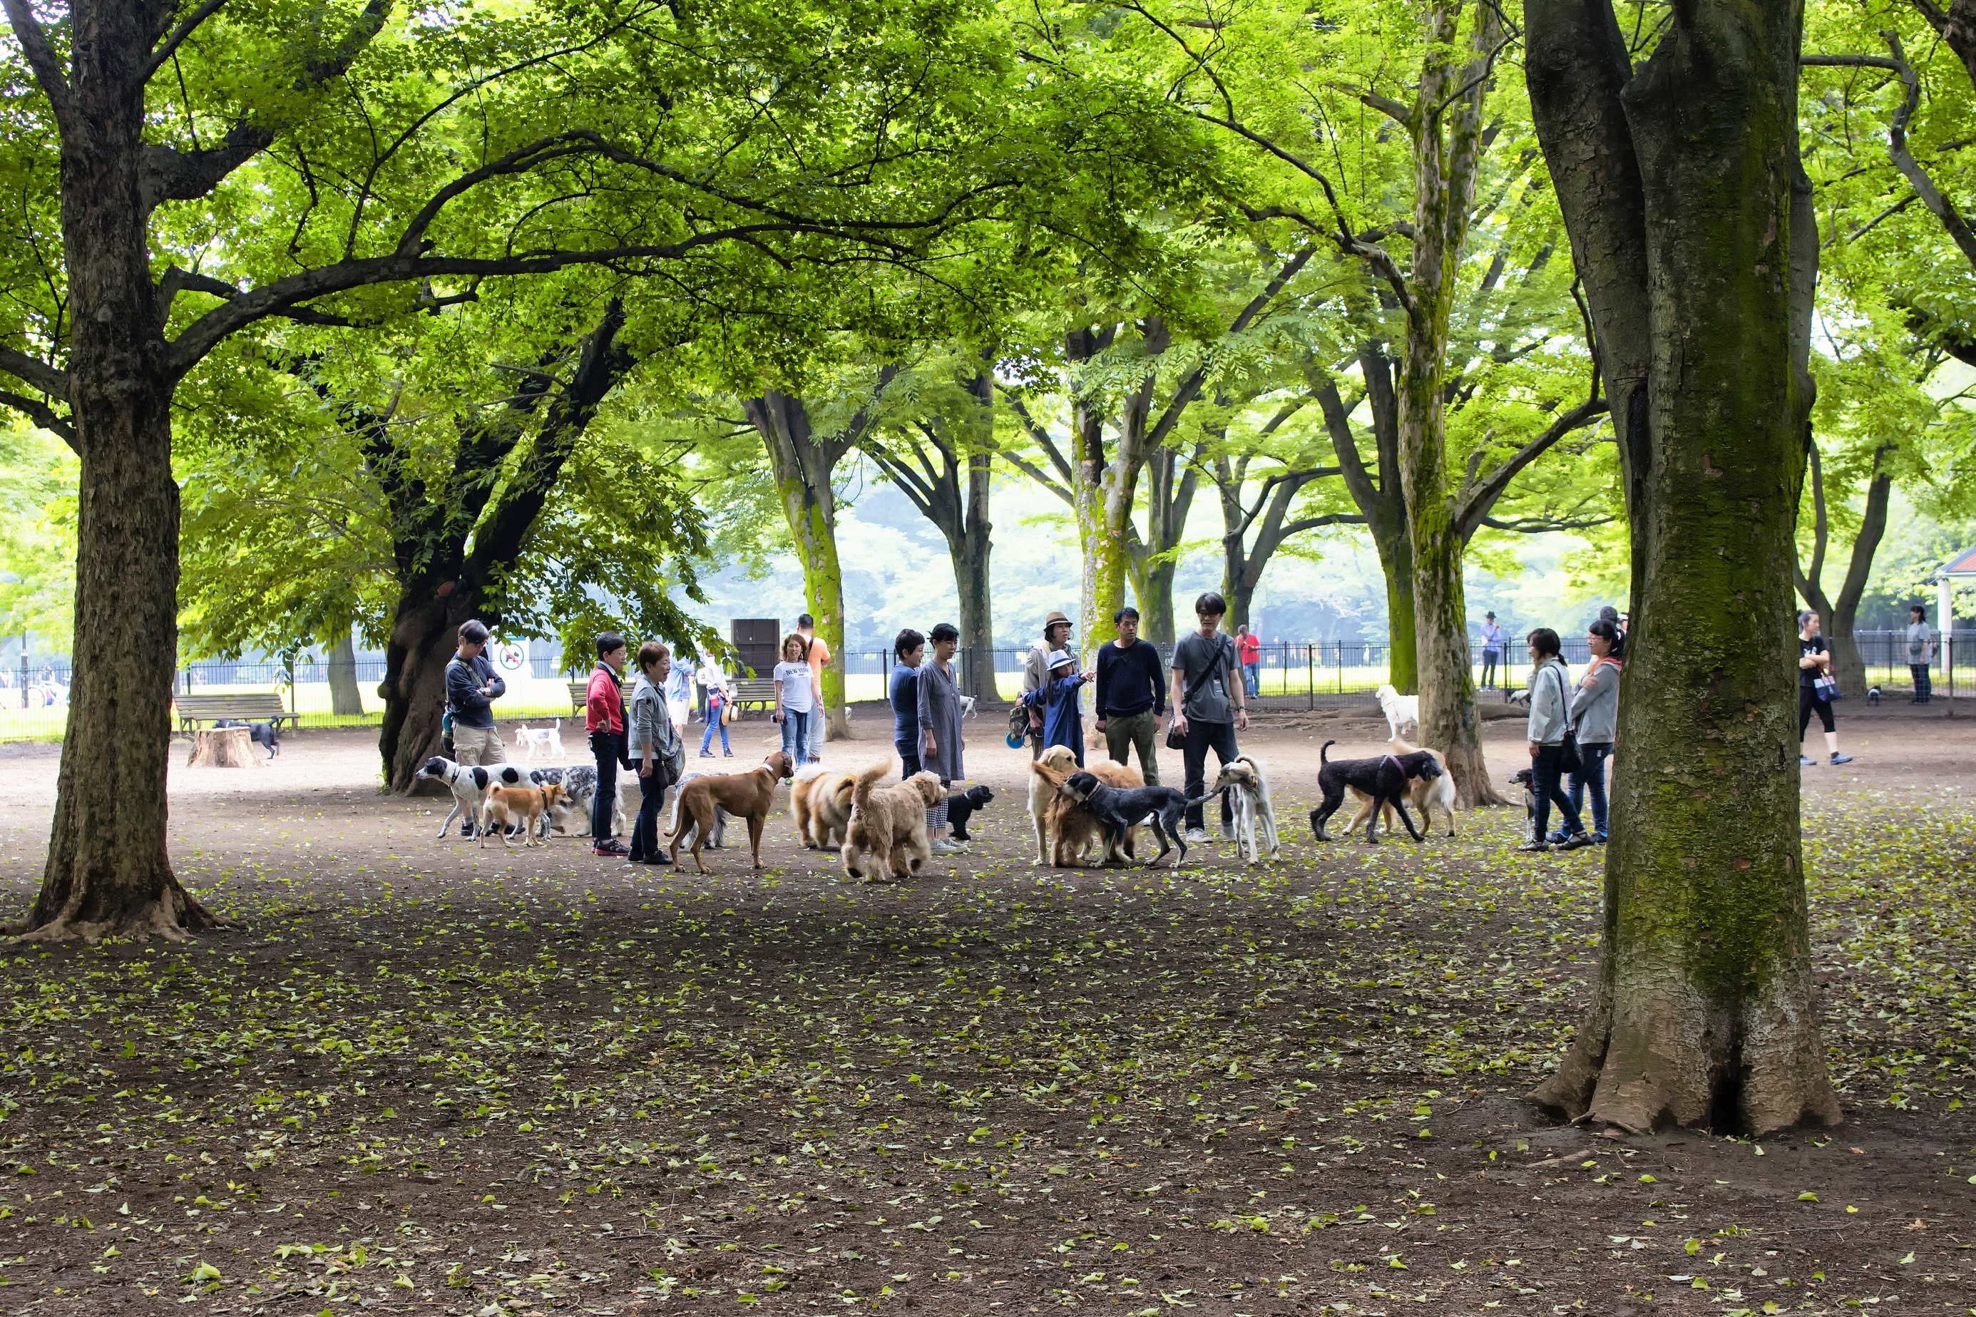

Slide 5
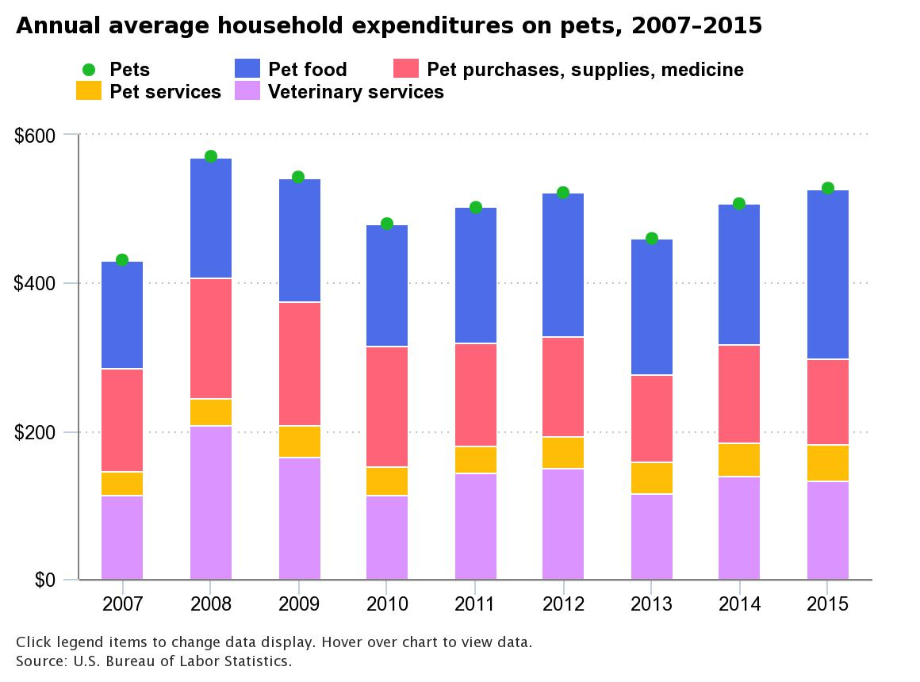
Households spent an average of USD528 (HK$4120) on pets.
Notes:
https://www.bls.gov/opub/ted/2017/households-spent-an-average-of-528-dollars-on-pets-in-2015.htm

Slide 6
Top 5 Health Issues Faced by Pets Today – WebMD¹
Pets are becoming medically underserved.
Obesity in pets, like in humans, is skyrocketing.
Research has shown pet owners are not likely to recognize obesity in their pets²
Diabetes is increasing in both cats and dogs.
32% increase in dogs; 16% increase in cats
Cancer: a major illness in both cats and dogs
1 in 4 dogs dies from cancer³
Dental disease is on the rise.
Source:
1. WebMD: https://blogs.webmd.com/pet-tales/2012/03/top-5-health-issues-facing-american-pets-today.html
2. PubMed.gov: https://www.ncbi.nlm.nih.gov/pubmed/22017760
3. Morris Animal Foundation
Notes:
https://blogs.webmd.com/pet-tales/2012/03/top-5-health-issues-facing-american-pets-today.html

Slide 7
Example of Monthly Spending on Dog
Products | Cost:
PetHealth™ Kit | HK$275.00
Ztore – Cesar classics canine cuisine (24 cans) | HK$238.00
Ztore – Natural 10 (For dogs) 4 pack | HK$172.00
MoMo Bugs Kindergarten Pets Hostel – 3 nights | HK$750.00
MoMo Bugs Kindergarten Pets Hostel – Hair Dressing | HK$400.00
We Care Paws – Lead rope | HK$130.00
We Care Paws – Oral care | HK$198.00
We Care Paws – Animal carrier | HK$720.00
Total Cost: | HK$2,883.00

Slide 8
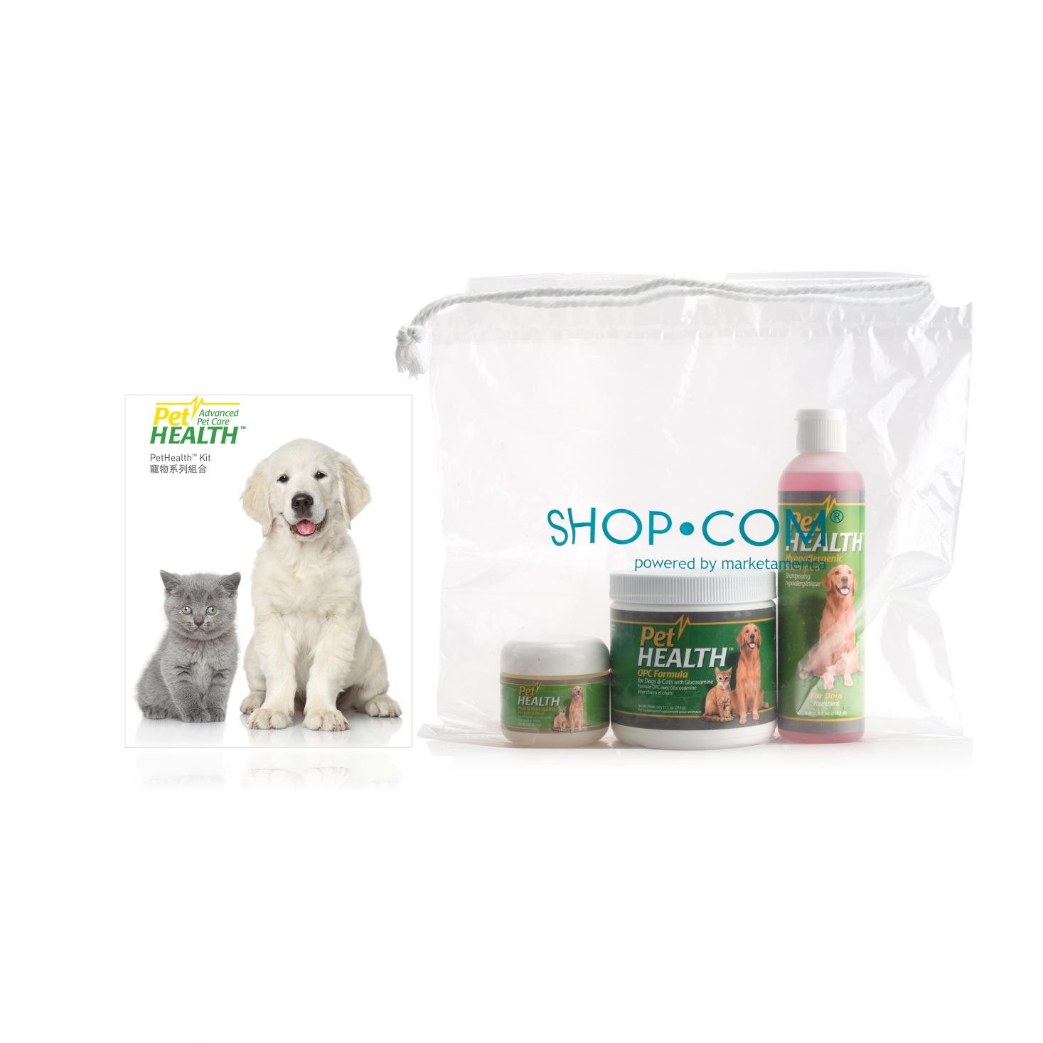
PetHealth™ Kit
Limited 20% Promotion
Code: HK5600｜UC: HK$275.00
SR: HK$388.00｜BV: 21

Slide 9
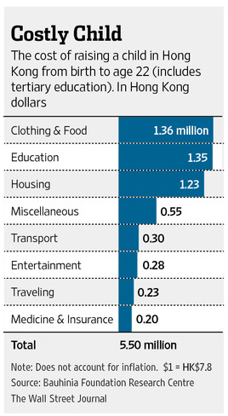
Want to Raise a Kid in Hong Kong? You’ll Need USD700,000 (HK$5,500,000) – Wall Street Journal
https://blogs.wsj.com/chinarealtime/2014/09/04/want-to-raise-a-kid-in-hong-kong-youll-need-700000/

Slide 10
Top Health Concerns for Children – University of Michigan¹
Childhood obesity
In Hong Kong, the detection rate of overweight and obesity in primary school students increased from 16.1% in 1995/96 to 20.0% in 2013/14 – DOH²
Drug abuse & Smoking
Most common reason for drug use: Relief of boredom/depression/stress – SCMP³
Stress
The number being treated for mental illness has increased by >50% from 2011-12 to 2015-16 – SCMP⁴
Alcohol abuse
Not enough opportunities for physical activity
Source:
University of Michigan: http://www.uofmhealth.org/news/1682top-10-health-concerns-for-kids
Department of Health: http://www.chp.gov.hk/files/pdf/ncd_watch_mar2015.pdf
SMCP: http://www.scmp.com/lifestyle/health-beauty/article/2102643/young-hongkongers-easy-access-illicit-drugs-ice-ketamine
SMCP: http://www.scmp.com/news/hong-kong/health-environment/article/2097852/hong-kong-children-suffer-greater-mental-stress

Slide 11
Example of Monthly Spending on Children
Product | Cost:
DNA iKids Combo + Miracle Isotonix Immune Powder Drink | HK $650
Ultimate Aloe Gel | HK $116
DNA Miracles Value Kit | HK $344
Global: DNA Miracles Essential Fish Oil | HK $304
Global: DNA Miracles Isotonix Digestive Enzyme Powder Drink | HK $460
Global: DNA Miracles Isotonix Multivitamin Powder Drink | HK $390
Bossini | HK $300
Ztore – Organic milk, cookies & pasta | HK $600
On Tin Organic– Organic meat & veggie | HK $500
Park n Shop – Paper towel, toothpaste | HK $200
Satay King | HK $100
Global: Better World Books | HK $500
Eshop Express – Light, snack, toy, crayon | HK $400
Total cost: | H$4,864
Extra Spending: ElectriCity– Air con, Apple – iPad, Morning Start – Travelling | HK $15,388

Slide 12
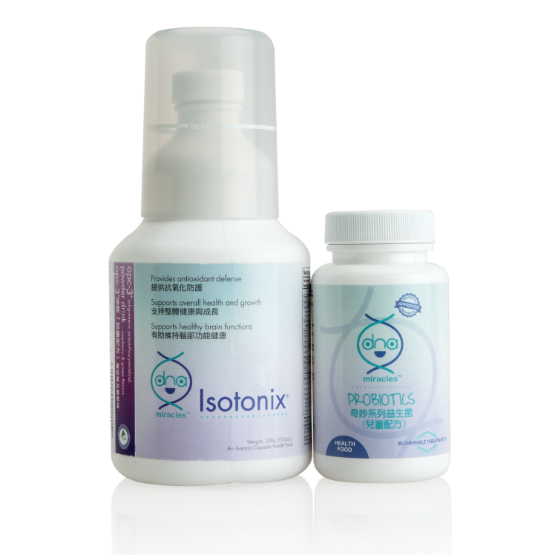
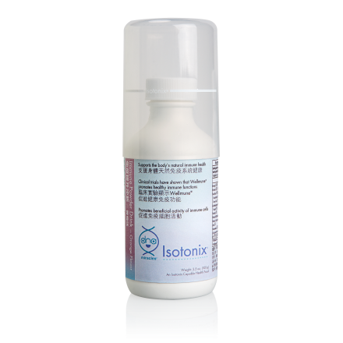
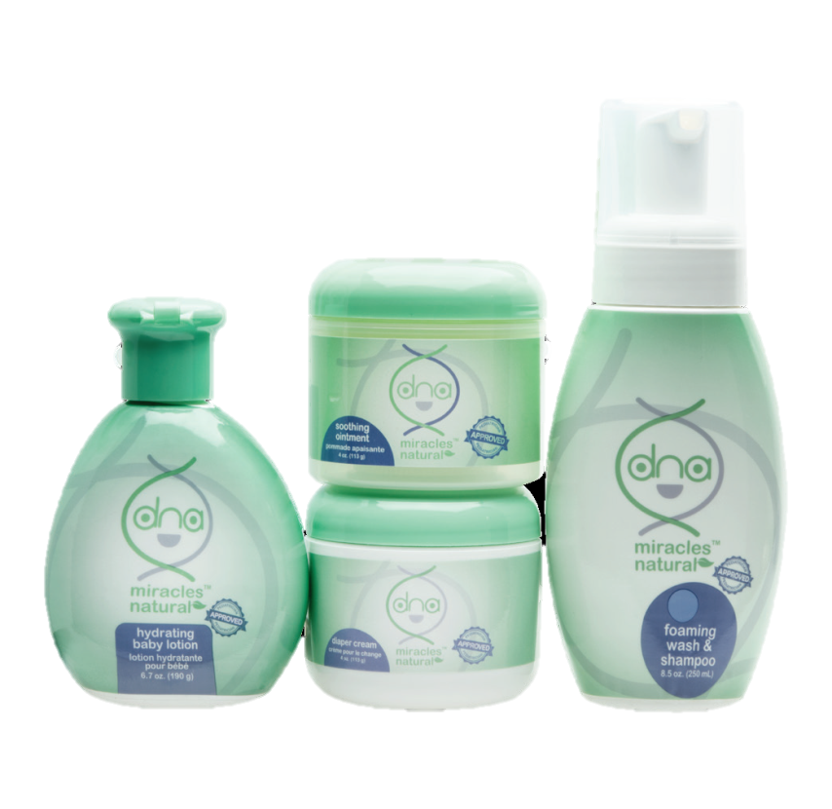
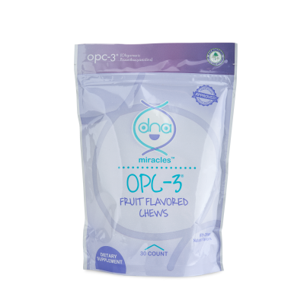
DNA Products
DNA Miracles
iKIDS Nutrition Combo
DNA Miracles
Isotonix Immune
Powder Drink
DNA Miracles
OPC-3 Chews
DNA Miracles
Value Kit

Slide 13
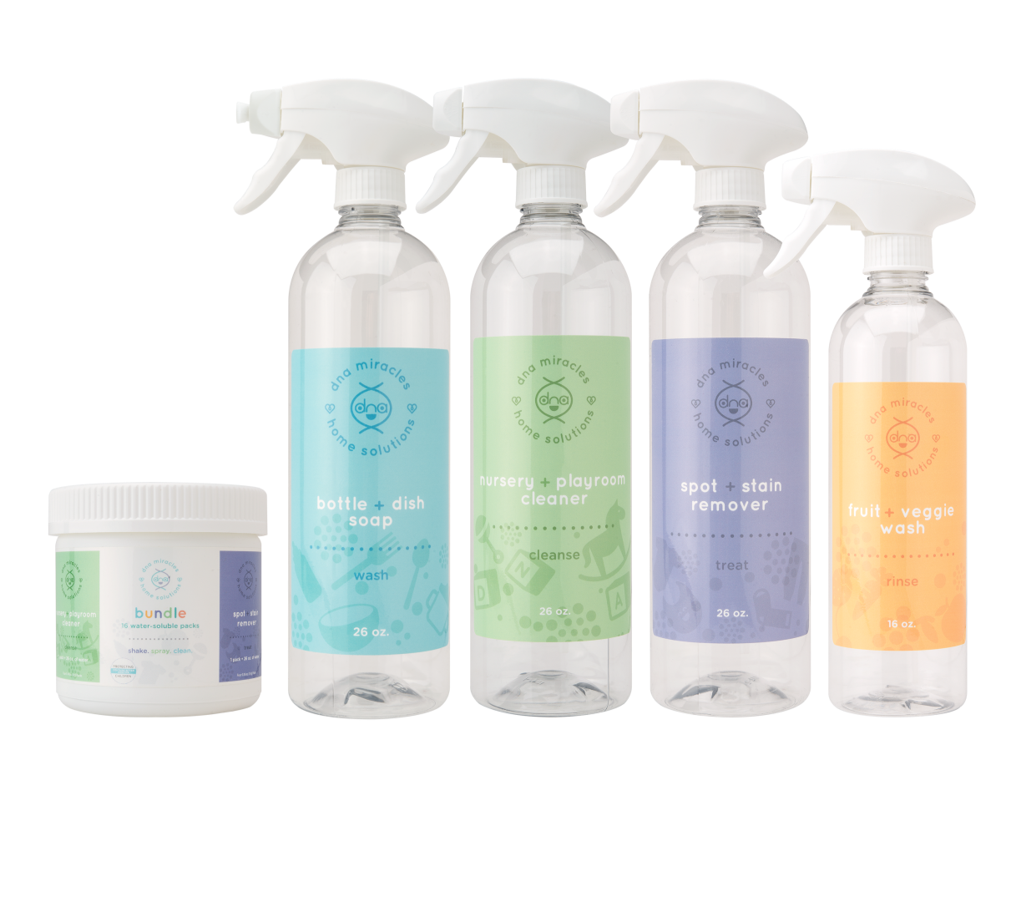
Introducing the new DNA Miracles® Home Solutions
HK6943
UC$270
SR$378
BV20

Slide 14
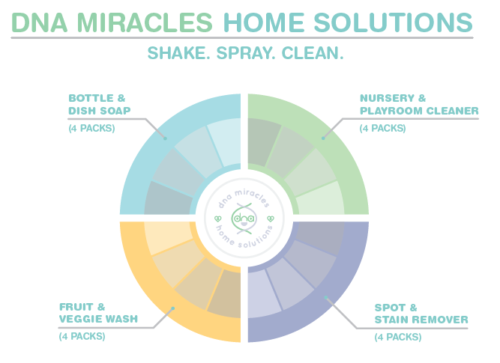

Slide 15
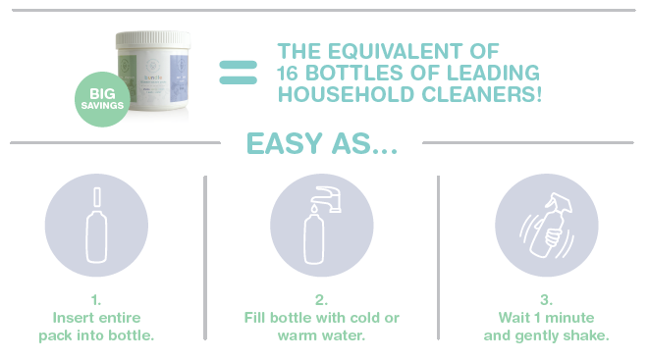

Slide 16
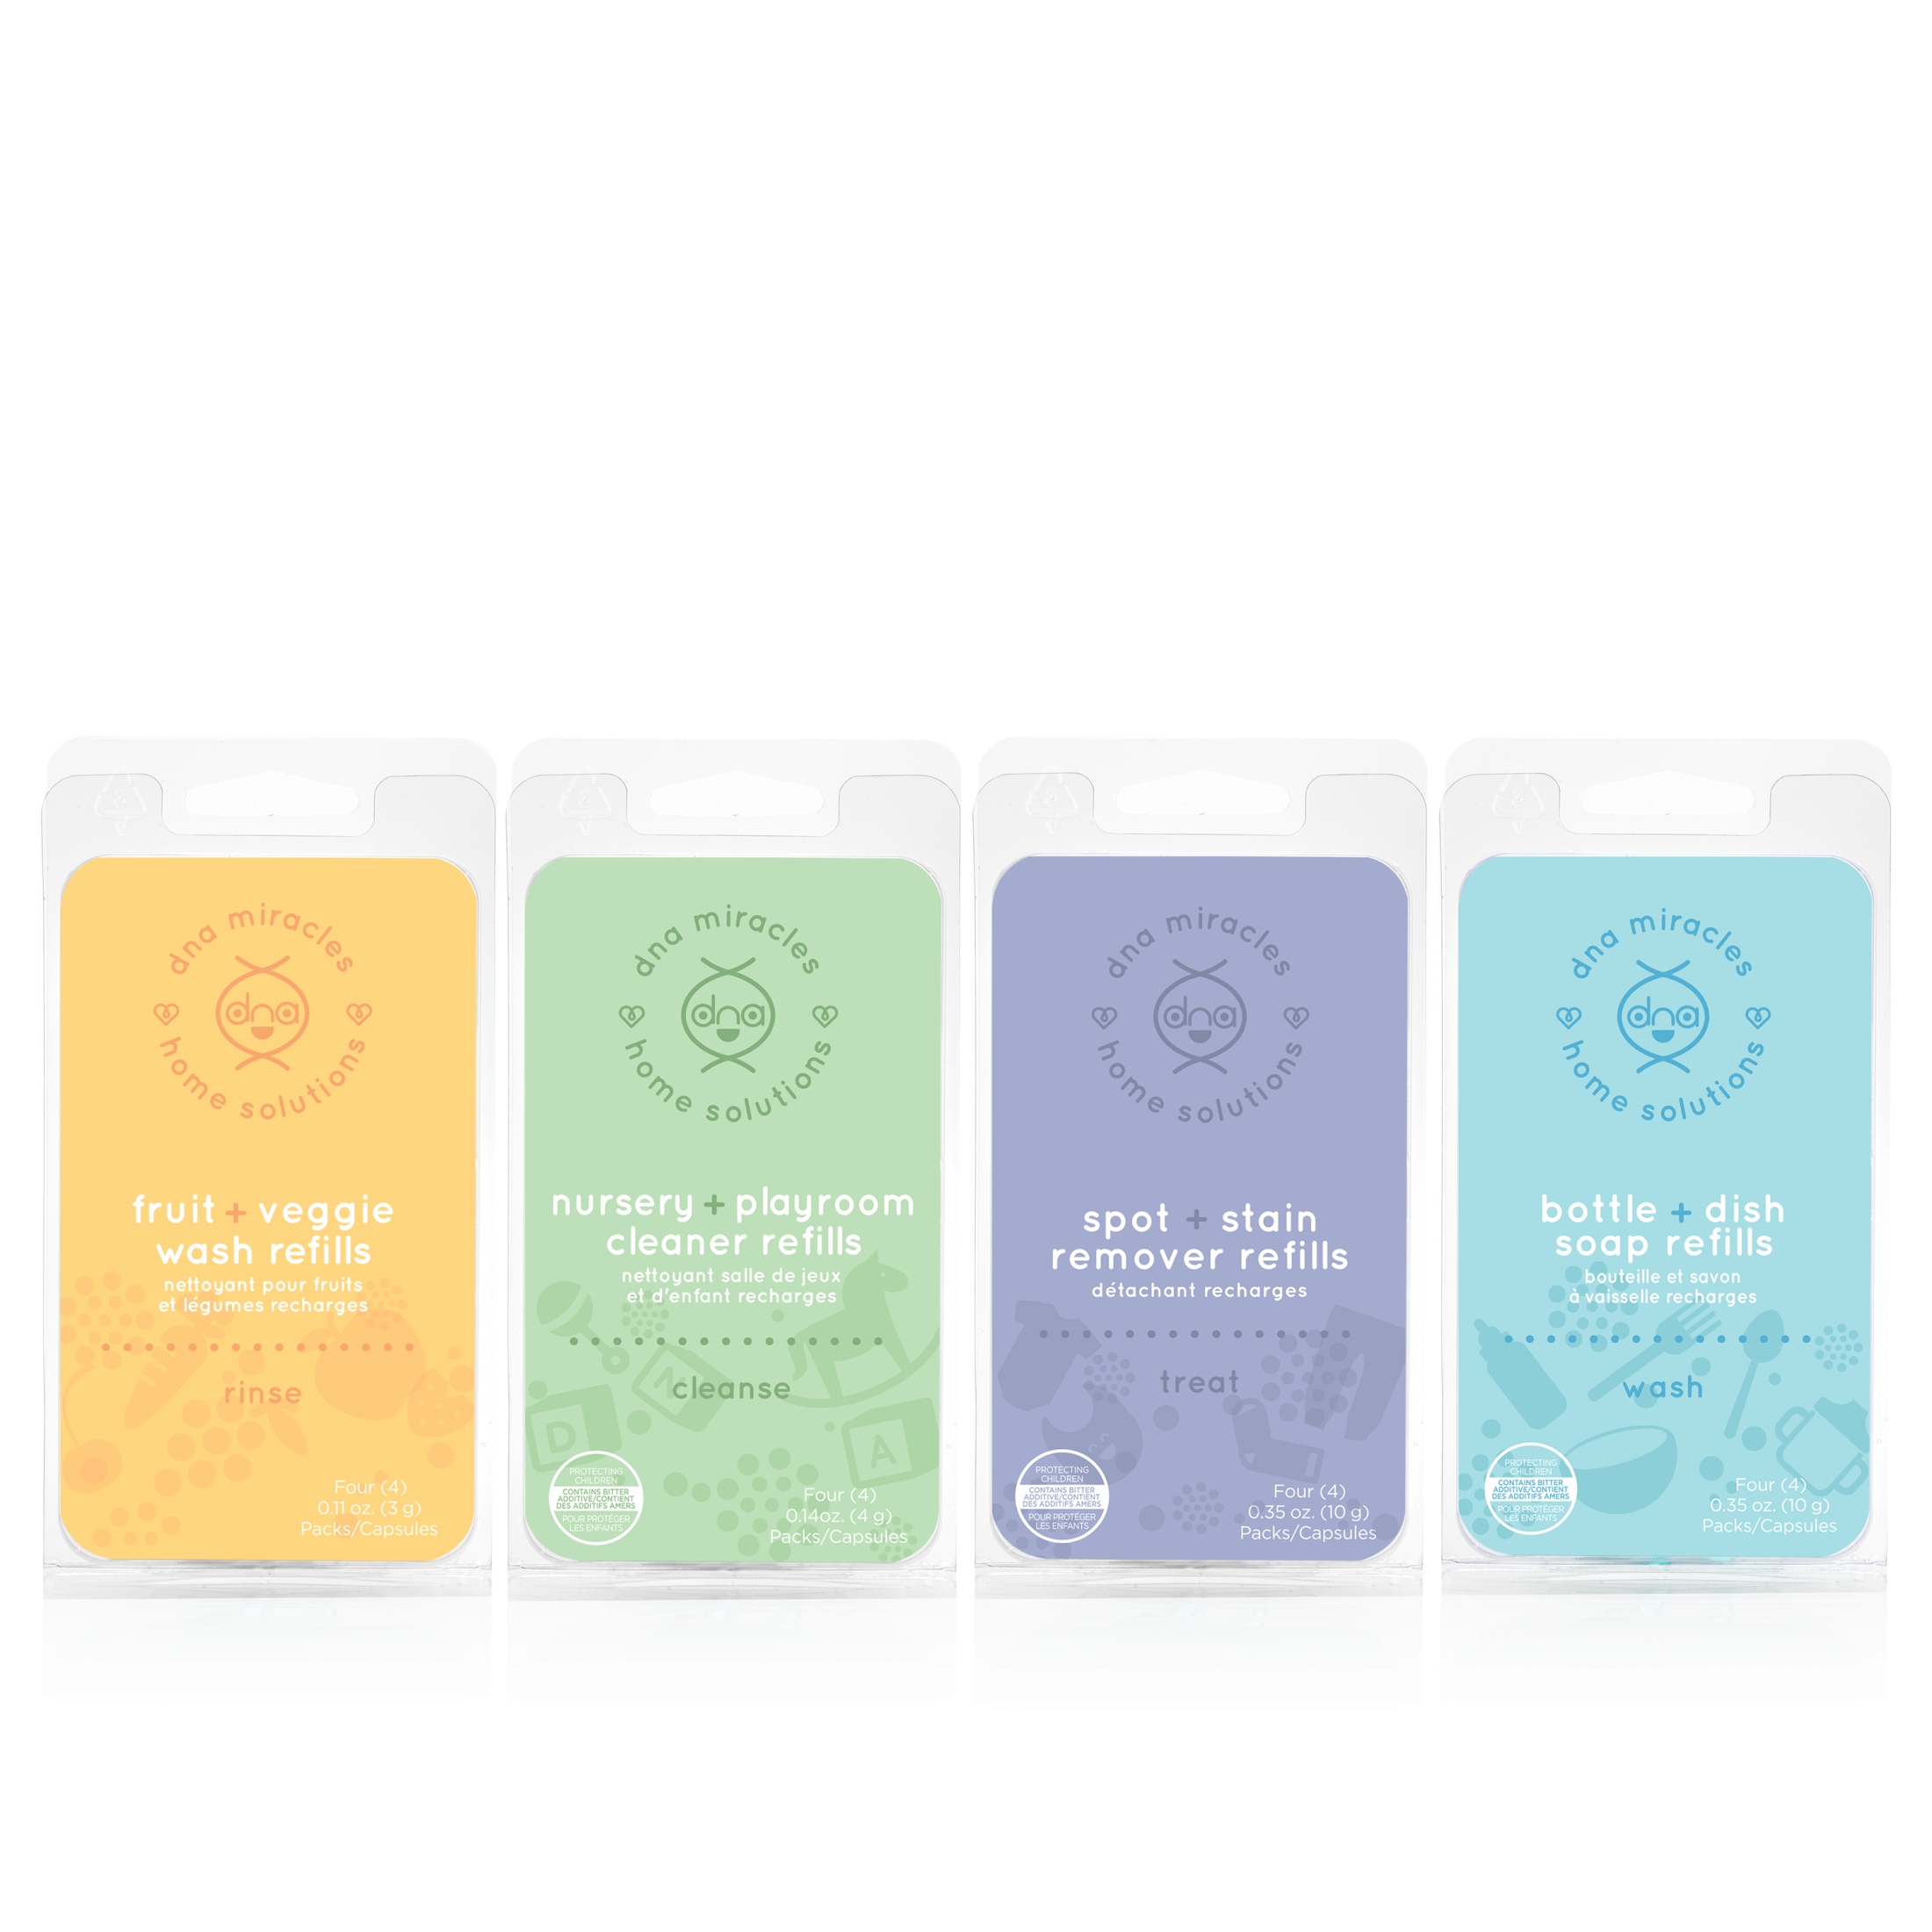
DNA Home Solution Refills
COMING
SOON IN DEC.
Code: varies
UC$70
SR$100
BV 4.50

